Slide 1
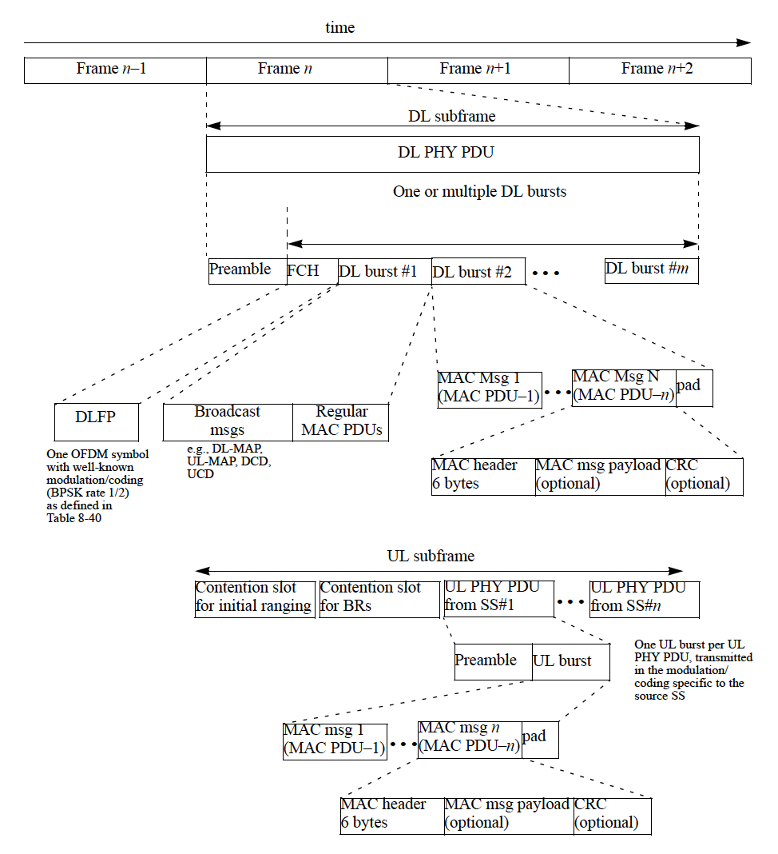
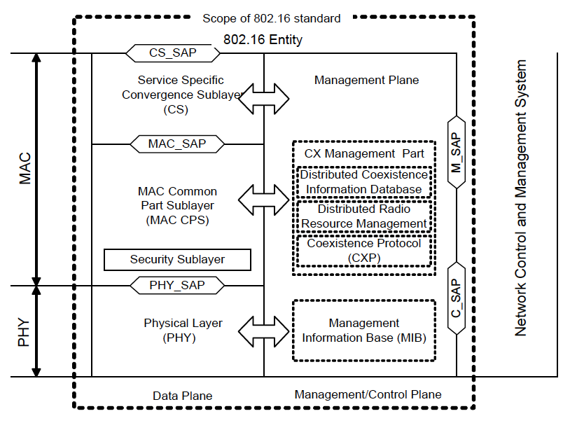
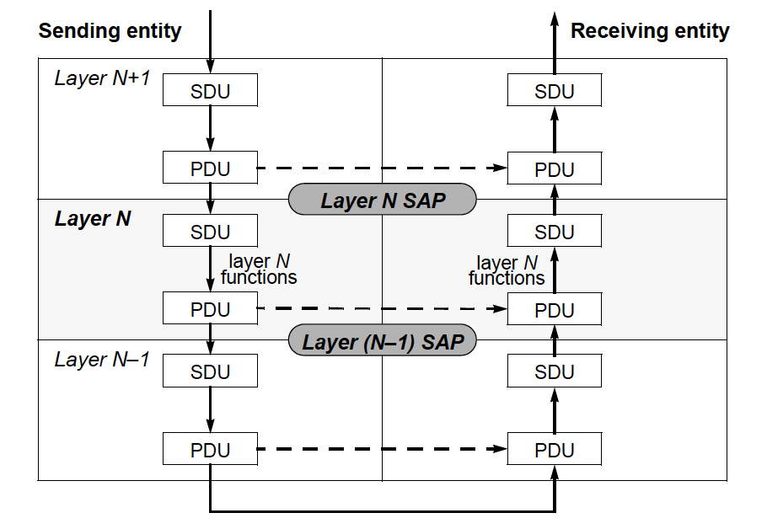
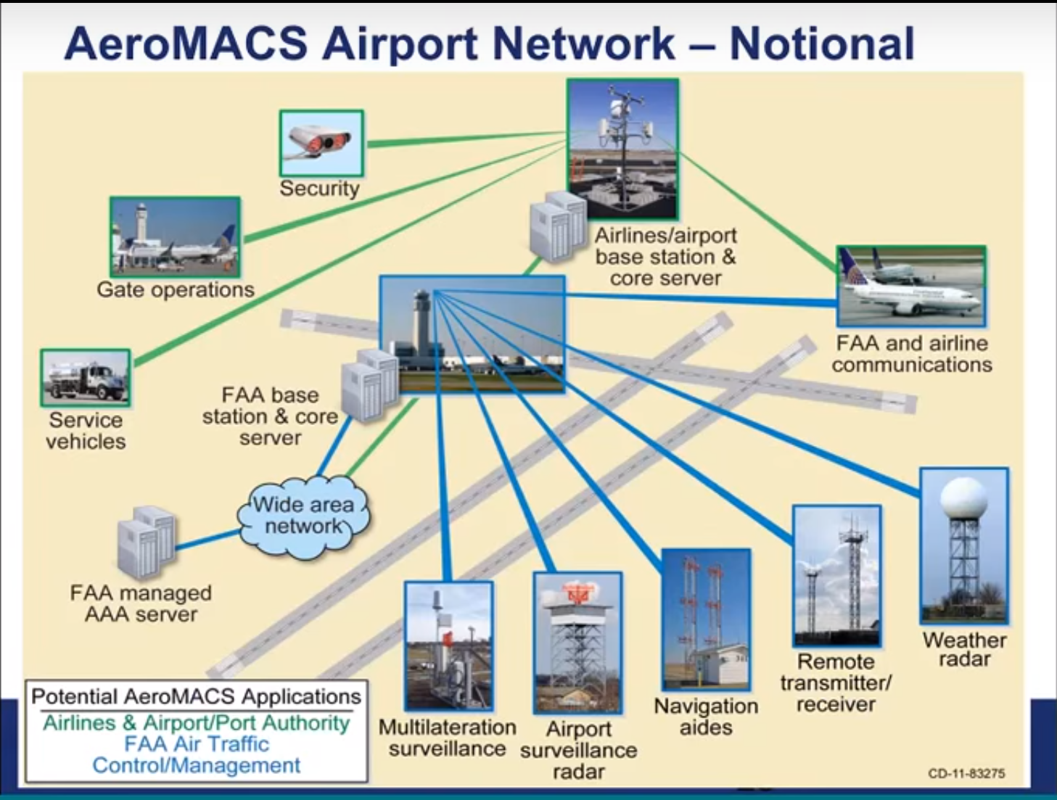
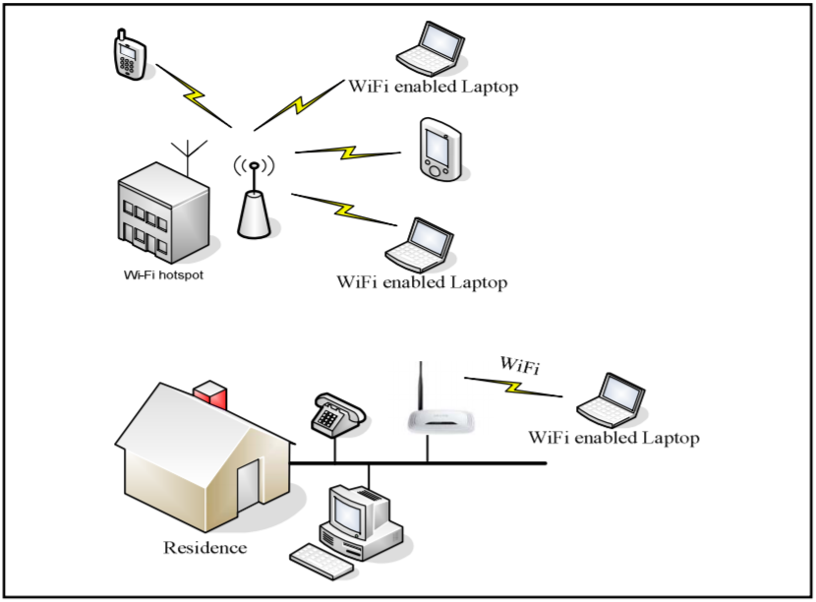
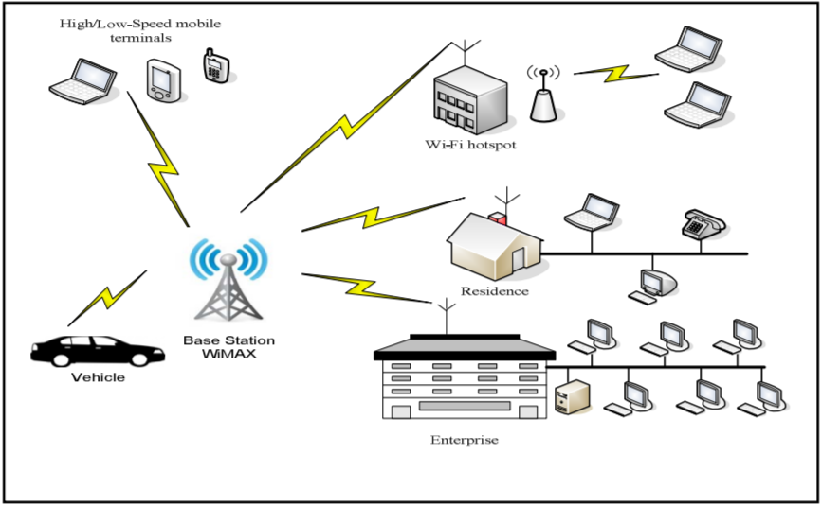
CNT 4514C
Wireless Networks and Mobile Computing
Spring 2018
Prof. Zornitza Genova Prodanoff
WiMAX: Past and Future Applications
Troy Bogle| Andrew Greer | Stephen Hartman | Seth Johnson
School of Computing
Abstract
Physical and Logical Topology
Summary
In the year 2001, the WiMAX Forum was founded to promote the usage of wireless broadband using the IEEE 802.16 standard. In the past 17 years the world has seen considerable advancement of wireless broadband technologies, including 3G, 4G, LTE, and WiMAX, along with 5G telecommunication in the near future.
WiMAX was a considerably reliable wireless broadband network with low startup costs and extensive enhancements to Orthogonal Frequency Division Multiplexing (OFDM) technology. Many cities implemented Municipal Area Networks (MAN) using WiMAX, with usage peaking in 2010. By 2011, 4G LTE and other widespread cellular broadband technologies were gaining market share due to the advent of smart phones which predominantly used cellular carrier broadband. By 2015, Sprint Networks began to phase out their recent acquisition of Clearwire, a WiMAX based internet service provider (ISP). Based on our review of the relevant literature, we believe that other technologies such as LTE are faster, more compatible, more widespread, and have less power consumption than many historical use cases for WiMAX in the United States.
In recent years, the WiMAX Forum has promoted several applications which could prove to be a force in the current wireless broadband market. This poster will focus on the WiMAX usage transition from wireless broadband pertaining to middle mile and last mile infrastructure, to more specific cases in the United States, particularly AeroMACS, a regional Ethernet infrastructure designed with airport authority communication in mind.
The IEEE Working Group 16 defined two access options for a WiMAX network: fixed (IEEE 802.16TM- 2004) and portable (IEEE 802.16eTM). In the fixed option, access is provided through a fixed antenna as in a satellite television subscriber station. In portable option, the subscriber stations are very similar to IEEE 802.11 WiFi stations.
The 802.16-2012 IEEE protocol document covers the logical and physical layers of point-to-multipoint wireless broadband technologies, which includes WiMAX. Figure 1-1 outlines the basic protocol layering for 802.16. The WiMAX physical layer operates in the 2-11 GHz range, which is defined in 802.16 as Non-Line-of-Sight (NLOS) wireless transmission. Figure 1-2 covers the standard physical network which includes Base Stations which are connected to multi-point Subscriber Stations, the hardware which connects the hosts using the logical layer. The frequency bands typically used are 2.5 GHz, 3.5 GHz, and 5.7 GHz to not interfere with WiFi protocols (2.4 and 5 GHz). WiMAX communicates using Orthogonal Frequency Division Multiplexing, single and multiple access versions (OFDM & OFDMA). Channel bandwidths are scalable from 1.5 to 20 MHz, but 20 MHz has been implemented frequently. Currently the maximum data rate is 75 Megabits per second at a maximum range of 10 kilometers in the 20 MHz bandwidth and 15 Megabits per second at a maximum range of 5 kilometers in the 5 MHz bandwidth.[4]
The logical topology includes the Medium Access Control Layer (MAC) and Logical Link Control (LLC) and the various mechanisms used to establish broadband links between base stations, subscriber stations, and host systems in the context of the Data Link Layer of the OSI Model. The MAC layer is separated into three different sublayers: the Convergence Sublayer (CS), the Common Part Sublayer (CPS), and the Security Sublayer. The service-specific CS provides any transformation or mapping of external network data, received through the CS service access point (SAP), into MAC service data units (SDUs) received by the MAC common part sublayer (CPS) through the MAC SAP.
An example illustrated in figure 4 shows Layer X addresses a XPDU (Layer X Protocol Data Unit) to a corresponding peer unit Layer X. That XPDU is received as an (X-1)SDU (Layer X-1 Service Data Unit) by Layer X-1 of the considered unit. Therefore, when an MPDU (MAC Protocol Data Unit) is sent by corresponding equipment, it is received as a PSDU (Physical Service Data Unit) in the same equipment in order to satisfy the protocol. 802.16 MAC is connection oriented, therefore WiMAX has mechanisms for requesting bandwidth, QoS and traffic parameters, along with transporting all routing and parameters to each appropriate sublayer.[4][5]. Figure 6 shows Orthogonal Frequency-Division Multiplexing frames, including MAC headers with layer 2 and ARQ information, downlink subframe with a preamble for synchronization, uplink subframe for SS bandwidth and range data, and other optional messages.[4]
Older WiMax is being replaced by LTE equipment. LTE can operate in the same frequency as WiMax, without need for leasing new spectrum. WiMAX allows for a distance of 30 miles vs 300 feet for Wifi. A slower speed is a penalty over a longer distance. A speed of 10 MBps could be achieved with a range of one to six miles. LTE has a higher capacity and range than WiMax. In 2015 a sharp decline in WiMAX usage was predicted in Africa, as users switch to LTE.
Although WiMax was the first mobile broadband, LTE won the battle against WiMax because LTE was an upgrade to existing technology. LTE won because it is less expensive to upgrade than to create a brand new technology. WiMax was still a major contributor to wireless broadband. Because of WiMax we now have MIMO, Space-Time Frequency Coding, Downlink Channel Reporting, and Beam Formatting. The WiMax Forum also has created what could very well be the new standard for airport systems communications in AeroMACS. The speed and reliability of AeroMACS combined with the lack of interference from the general public on its frequency range has resulted in stable and clear communications in and around the runway.
LTE also saw widespread use in the US, where no major cellular carriers adopted the WiMAX protocol and infrastructure, leaving the country lacking in most any form or presence of the technology. Still, WiMAX is very practical in countries where last-mile coverage is tough to achieve due to its superb range on a wireless signal. This has lead the technology to having around one billion people reached through the WiMAX service.
Figure 3: PDU and SDU in protocol stack [4]
Figure: 4: PDU and SDU in protocol stack [4]
Figure: 6: OFDM Frame Structure [4]
Comparison
Future Developments
Successes and Failures
References
A competitor to WIMAX is Long Term Evolution (LTE). LTE allows 300 Mbps downstream and 100 Mbps upstream. LTE uses the current UMTS infrastructure. The main difference between LTE and WiMAX is that LTE, is slightly faster, made made to work with existing mobile broadband deployments, and they operate on different frequencies (LTE 700 Mhz vs. WiMAX 2.3 and 3.5 GHz). WiMAX is also easier to setup.
WiFi is a direct competitor to WiMAX. WiFi is more widely adopted in developed nations, where last-mile coverage is not as necessary or hard to achieve as less developed and more rural countries [3]. In 2011, the WiMAX Forum estimated that WiMAX service reached almost one billion people, but hopes of reaching the US market have been centered on the wireless carrier Sprint’s adoption of the service[7]. As of 2011, WiMAX was available in 71 markets around the US and is based on the 802.16e mobileWiMAX standard[7].
WiMAX may not have been a global success but it was the spark of innovation needed for the invention of AeroMACS (Aeronautical Mobile Airport Communication Systems). Based upon the WiMAX IEEE standard (802.16e), AeroMACS was first proposed by the WiMAX forum in 2017. The objective is to provide more efficient communication on United States airfields between air traffic controllers, aircraft pilots, aircraft authorities, and support crew [1].
AeroMACS operates in the protected and licensed aviation spectrum band from 5091 MHz
to 5150 MHz. The
technology is now
internationally
standardized and has
been implemented in
over 30 airports
worldwide. In the past
year, the WiMAX
Forum has petitioned
to the FCC for
AeroMACS service
rules to be adopted
in the United States [1].
One of the main advantages of WiMAX is that it allows communication of 30 miles – compared to 300 feet for WiFi. The speed may be slower over longer distances, but it is still faster and has a longer range than WiFi. WiMAX alone can provide the same quality service at a fraction of the cost. A reason for WiMax’s failure is compatibility. Although LTE arrived much later than WiMax, it was actually just an upgrade to existing networks. WiMax is a new technology, and mobile operators, who already had money invested in 3G networks, were wary of investing heavily in a brand new technology [6].
Although WiMax lost the battle against LTE, it provided the following advancements:
1. MIMO (Multiple Input Multiple Output) Technology where there are multiple antennas at the base station & at the wireless device. MIMO improves reception and rate of transmission.
2. Space-Time Frequency Coding – A method of encoding data at the transmitter and decoding data at the receiver.
3. Beam Formatting - Provides a better signal in low data rate areas. An array of antennas creates signals that interfere spatially to provide a stronger signal in areas that were on the edge of the antenna range.
4. Downlink Channel Reporting - In a noisy area, data will be sent at a lower rate but with a clear connection higher data rates are used.
[1] Unknown Author, “AeroMACS.” Last accessed from: http://wimaxforum.org/Page/AeroMACS on February 21, 2018
[2] Unknown Author, “Expect Enormous Changes in Aviation Performance with Certified AeroMACS Webinar” accessed from: https://www.youtube.com/watch?v=yh8xPf7zMuo
[3] D. R. Selvarani and T. N. Ravi, "Comparative analysis of Wi-Fi and WiMAX," International Conference on Information Communication and Embedded Systems (ICICES2014), Chennai, 2014, pp. 1-7.
[4] “802.16-2012 - IEEE Standard for Air Interface for Broadband Wireless Access Systems.” IEEE Xplore, 17 Aug. 2012, pp. 1–2544. IEEE.
[5] L. Nuaymi, WiMAX: technology for broadband wireless access. Chichester: J. Wiley, 2007.
[6] Rashvand, H.F. (2008). WiMAX cybercity & NGN. 108. 10.1145/1506270.1506402. · Source: DBLP Conference: Conference: Proceedings of the 5th International Conference on Mobile Technology, Applications, and Systems, Mobility Conference 2008, September 10-12, 2008.
[7] Dooley, B. J. (2011). The Definitive Analysis of Broadband Wireless Networks : WiMax, WiFi, LTE, and 4G Infrastructure. [S.l.]: Mind Commerce
[8] Sangwan, Parul; Nandal, Vikas. Ber Performance Review Of WiMax MIMO System International Journal of Advanced Research in Computer Science , Nov/Dec2017, Database: Applied Science & Technology Source
Figure 1: Wireless LAN infrastructure [3]
Figure 2: WiMAX infrastructure [3]
Figure: 5: AeroMACS infrastructure [2]
Troy Bogle: 904-206-1408 | Andrew Greer: 904-300-5029 | Stephen Hartman: 904-993-6669 | Seth Johnson: 321-474-6269

